Slide 1
Session 3.1: Building Landscapes
Disinformation/Malign Influence Training
SJ Terp & P Breuer, Threet Consulting | 2021

Slide 2
Landscapes
Building Landscapes:
Building an information landscape
Building a threat landscape
Building a response landscape
Landscape interactions
Landscape patches

Slide 3
Cognitive Security Ecosystems

Slide 4
Cognitive Security Ecosystem
Information Landscape
Information seeking
Information sharing
Information sources
Information voids
Threat
Landscape
Motivations
Sources/ Starting points
Effects
Misinformation Narratives
Hateful speech narratives
Crossovers
Tactics and Techniques
Artifacts
Response
Landscape
Monitoring organisations
Countering organisations
Coordination
Existing policies
Technologies
etc
Notes:
There are many actors in this space. We hear a lot about threat actors - these are at different scales, with different capabilities and motivations. They’re learning from each other, and they often interact - for instance, we see t-shirt sellers picking up geopolitical narratives.

Slide 5
Information landscapes

Slide 6
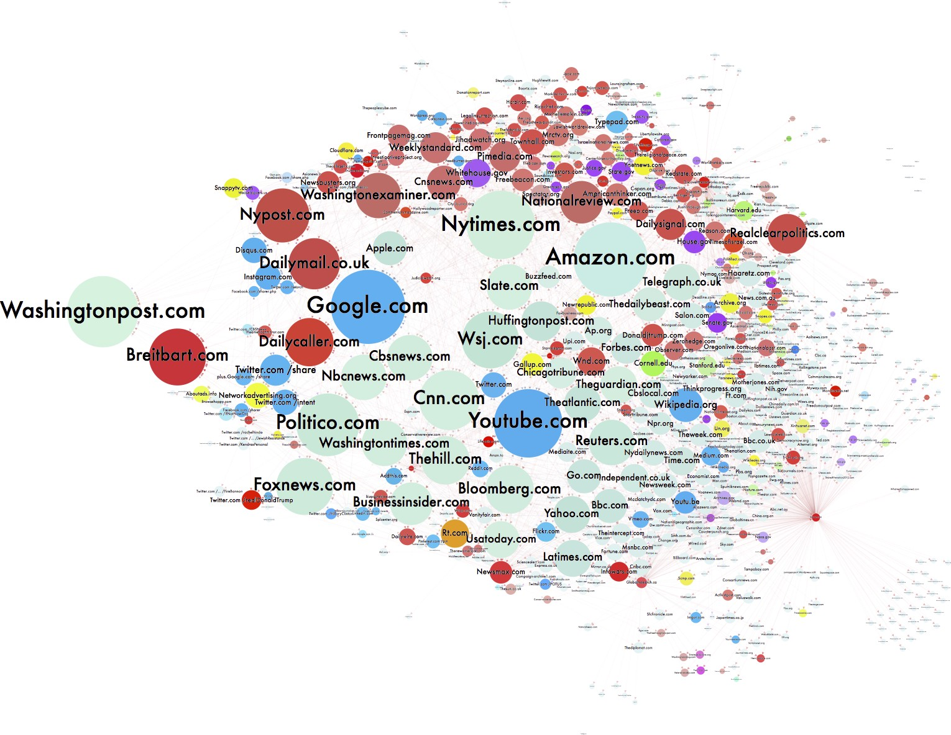
Channels
Lots of channels:
Where people seek, share, post information
Where people are encouraged to go
Image: https://d1gi.medium.com/the-election2016-micro-propaganda-machine-383449cc1fba
Notes:
IMage: https://d1gi.medium.com/the-election2016-micro-propaganda-machine-383449cc1fba

Slide 7
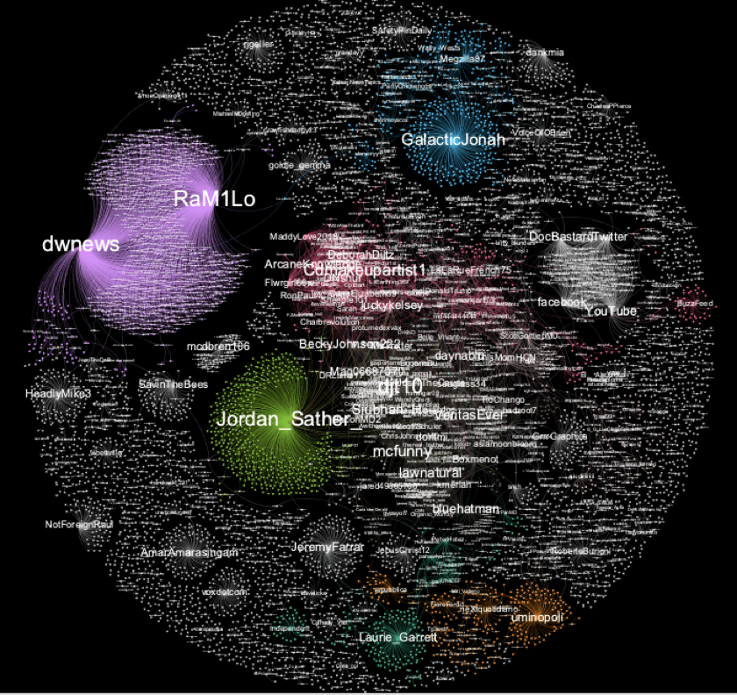
Influencers
Users or accounts with influence over a network
Not the most followers
The most influence
Might be large influence over smaller groups.

Slide 8
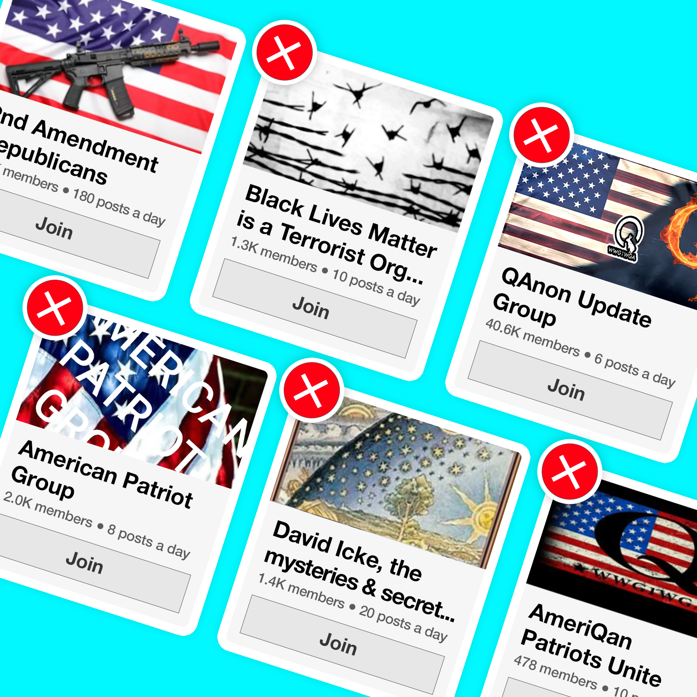
Groups
Social media groups created to create or spread disinformation
Often real members, fake creators
Lots of themes
Often closed groups
Notes:
Image: https://accountabletech.org/campaign/stop-group-recs/

Slide 9
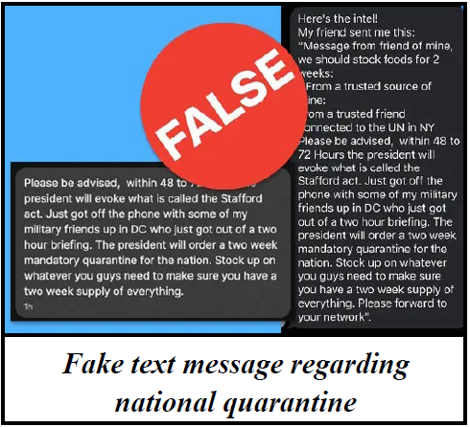
Messaging
Narratives designed to spread fast and be “sticky”
Often on a theme
Often repeated
Image: https://www.njhomelandsecurity.gov/analysis/false-text-messages-part-of-larger-covid-19-disinformation-campaign
Notes:
Image: https://www.njhomelandsecurity.gov/analysis/false-text-messages-part-of-larger-covid-19-disinformation-campaign

Slide 10
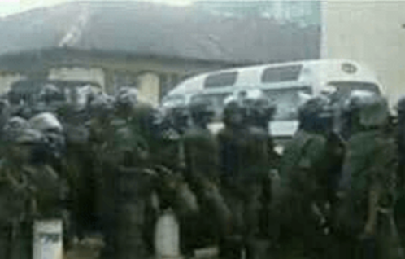
Example Information Landscape
Channels
Traditional Media
Newspapers
Radio - including community radio
TV
Social Media
Facebook
Whatsapp
Twitter
Youtube/ Telegram/ etc
Others
Word of mouth
Influencers
Groups
Messages
Notes:
Looking at information seeking, sharing, and posting behaviours.

Slide 11
Threat landscapes

Slide 12
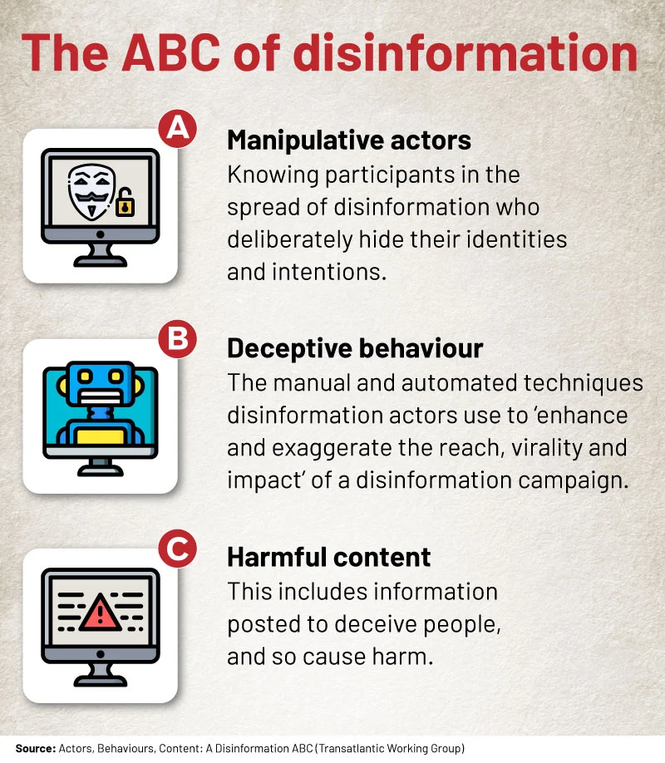
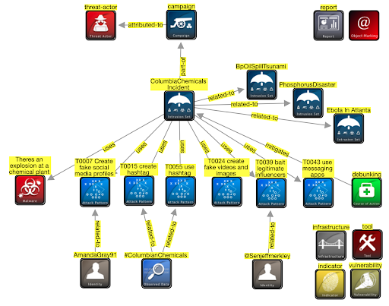
ABC model, STIX model
Notes:
ABC from https://africacheck.org/fact-checks/reports/anatomy-disinformation-campaign-who-what-and-why-deliberate-falsehoods-twitter

Slide 13
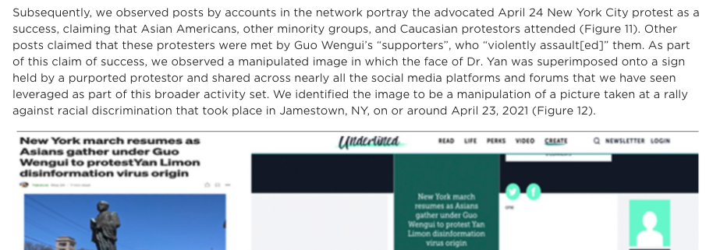
Incidents
Time-limited events (typically 2-3 days)
Areas include:
Elections
Disasters
Other events (e.g. Covid19)
Geopolitical support (e.g. Crimea)
Notes:
https://www.fireeye.com/blog/threat-research/2021/09/pro-prc-influence-campaign-social-media-websites-forums.html

Slide 14
Narratives
Covid isn’t serious
Covid doesn’t exist
Individual medical targets
Medical scams
MMS prevents
Alcohol prevents
etc
Origin myths
Escaped bioweapon
Country x created Covid
US soldiers took Covid to China
Resolution myths
Country y has a Covid cure
Crossover with conspiracies
Covid and 5G
Covid and antivax / anti-Gates
Helicopters spraying for covid
Depopulation conspiracy
Crossover with ‘freedom rights’
Anti- stayathome
2nd amendment
anti-immigration
Usual far-rightwing groups
Geopolitics
China, Iran: covert + overt
“Blue check” disinfo

Slide 15
Campaigns / Persistent Manipulators
Advanced Persistent Manipulators: “with resources, talent, and technology for advancing their influence over an enduring period” (Clint Watts)
Gen 1: disrupt the system: hacktivists
Hacking to shape public opinion
Gen 2: exploit the system: extremists (ISIS)
Social media influence
Gen 3: distort the system (Russia)
Social media influence fusion centre (personas, news sites, include in-person influence),
Gen 4: dominate the system (trolling as a service)
AI, social bots, false content, in-person, apps
Gen 5: Own the system (China, corporations)
Internet balkanisation to apps, create preferred reality
Notes:
https://www.fpri.org/article/2019/03/five-generations-of-online-manipulation-the-evolution-of-advanced-persistent-manipulators/

Slide 16
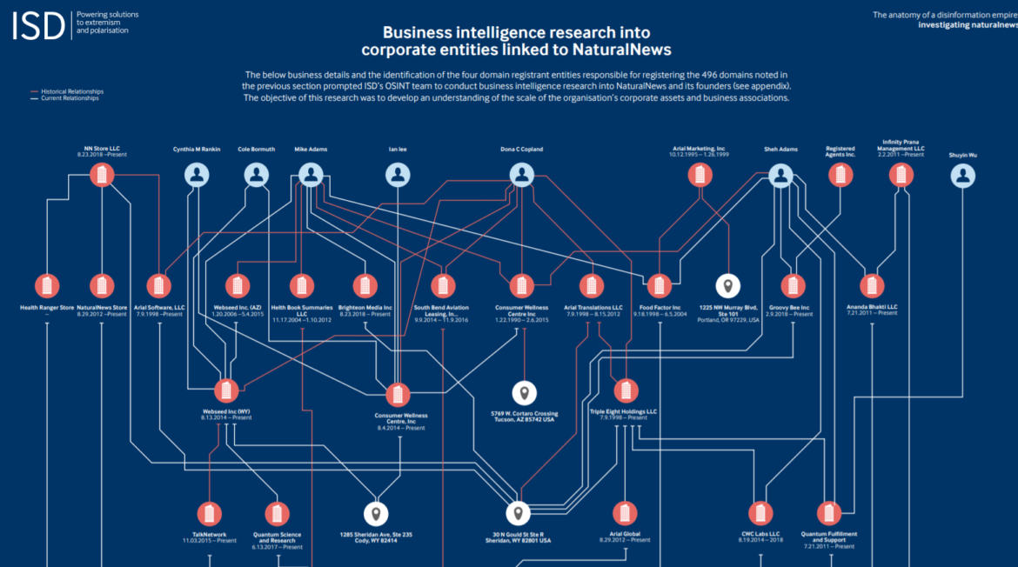
Actors
Entities behind disinformation
Nationstates
Individuals
Companies
Entities part of disinformation
DAAS companies
Image: https://gijn.org/2020/07/08/6-tools-and-6-techniques-reporters-can-use-to-unmask-the-actors-behind-covid-19-disinformation/

Slide 17
Disinformation Actors
Persistent Manipulators
Advanced teams
Internet Research Agency
China, Iran teams etc
For-profit website networks
Antivax websites
Pink slime sites
“Stolen” US election sites
Nationstate media
Sputnik
Russia Today
Service
Providers
Disinformation as a Service
Factories
Ex-marketing, spam etc
Ad-Hoc paid teams
EBLA Ghana
PeaceData USA
Opportunists
Wares Sellers
Clicks
T-shirts
Books etc.
Groups
Conspiracy groups
Extremists
Individuals
Attention-seekers
Jokers etc
Notes:
There are many actors in this space. We hear a lot about threat actors - these are at different scales, with different capabilities and motivations. They’re learning from each other, and they often interact - for instance, we see t-shirt sellers picking up geopolitical narratives.

Slide 18
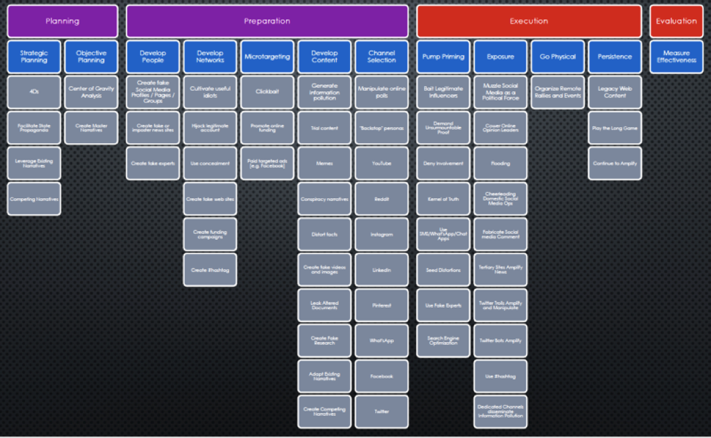
Behaviours
Techniques used in misinformation or disinformation campaigns
Useful to track because they’re often repeated, and we can design mitigations and countermeasures

Slide 19
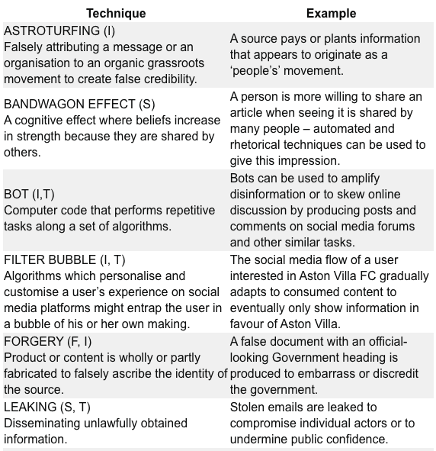
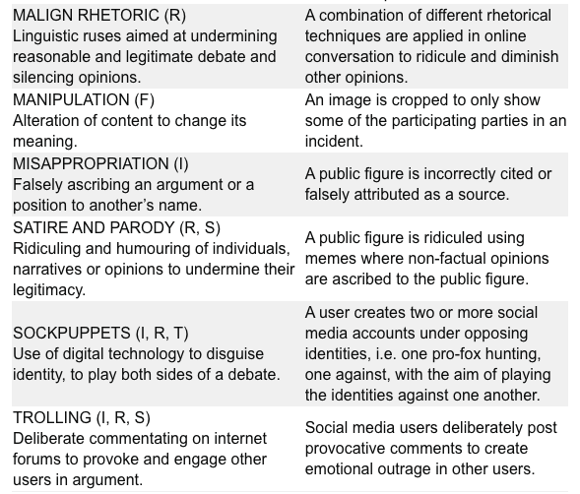
Behaviours (RESIST toolkit)
Notes:
https://gcs.civilservice.gov.uk/publications/resist-counter-disinformation-toolkit/

Slide 20
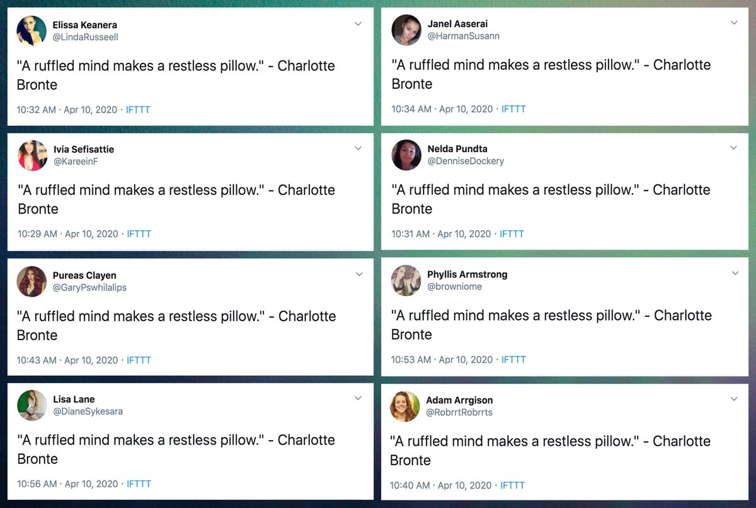
Tools
Bots
IFTTT variants
Personas
Network analysis
Marketing tools
Image: https://twitter.com/conspirator0/status/1249020176382779392

Slide 21
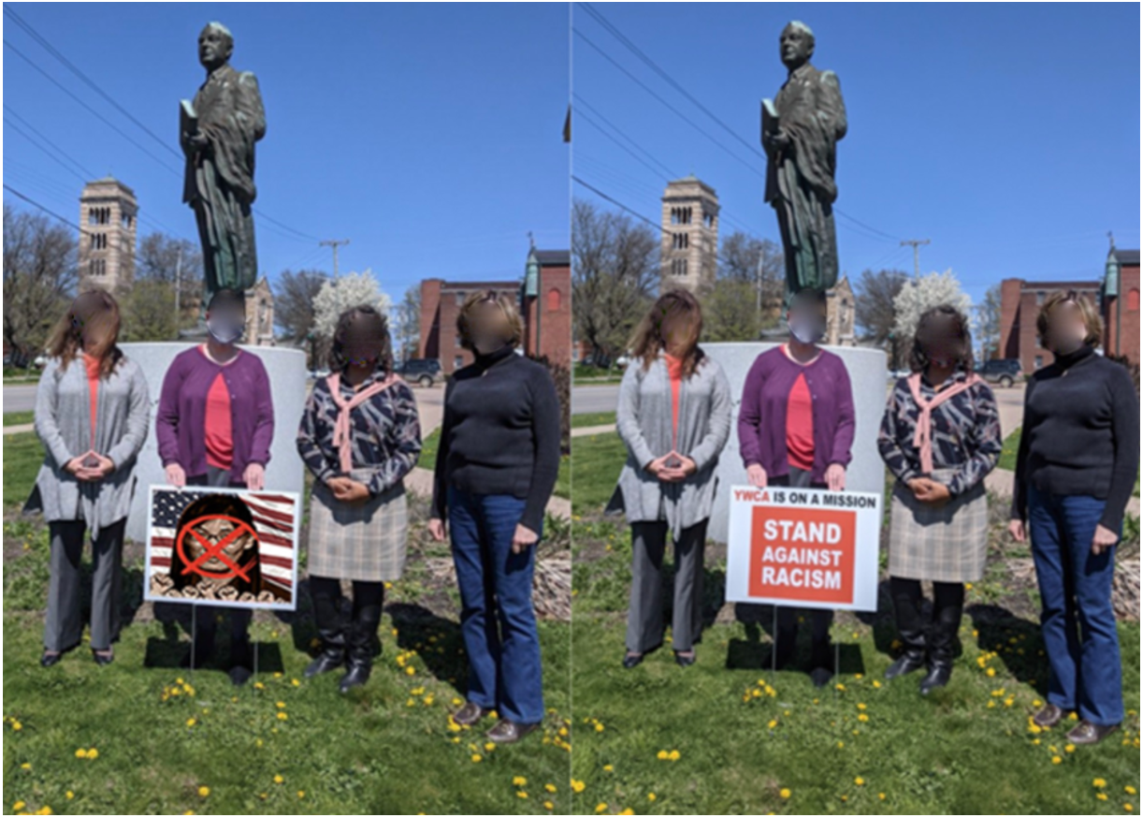
Artifacts
Text, images, videos, audio etc
Accounts, groups
Connections between them
Image: https://www.fireeye.com/blog/threat-research/2021/09/pro-prc-influence-campaign-social-media-websites-forums.html

Slide 22
Example Threat Landscape
Motivations
Geopolitics mostly absent
Party politics (internal, inter-party)
Actors
Political parties
Nationstates
Entrepreneurs
Activities
Manipulate faith communities
discredit election process
Discredit/discourage journalists
Attention (more drama)
Potential harms / severities
Assassination
Voting reduction
Sources
WhatsApp
Blogs
Facebook pages
Online newspapers
Media
Routes
Hijacked narratives
Whatsapp to blogs, vice versa
Whatsapp forwarding
facebook to whatsapp
Social media to traditional media
Social media to word of mouth

Slide 23
Response landscapes

Slide 24
Response Actors
Disinformation SOCs
Large actors
ISAOs
Platforms
Other large actors
Event-specific
War rooms
Agencies
Disinformation Teams
Disinformation “desk"
In existing SOC
Standalone unit
Investigators
Journalists
Academics
Independent journalists
Other Responders
Policymakers
Law enforcement
Corporations
Influencers
Nonprofits
Educators
Individual researchers
Concerned citizens
Notes:
But there are also response actors in this space. These are also at different scales, with different motivations, capabilities, and connections. Our work is on how best to join these together into a coordinated rapid response.
And to do this, we’re borrowing the idea of a Security Operations Center or SOC - a coordinating unit, focussed on cognitive security, connected to other disinformation SOCs. These organizations are starting to exist. This won’t be the same for everyone, so we’re designing operations for different sizes of organization, from ISAO sized down to small teams embedded in an information security unit, to independent teams, with connections to a response network, maybe as information providers or responders.

Slide 25
Example Response Landscape
(Needs / Work / Gaps)
Risk Reduction
Media and influence literacy
information landscaping
Other risk reduction
Monitoring
Radio, TV, newspapers
Social media platforms
Tips
Response
Messaging
prebunk
debunk
counternarratives
amplification
Actions
removal
other actions
Reach
Analysis
Tier 1 (creates tickets)
Tier 2 (creates mitigations)
Tier 3 (creates reports)
Tier 4 (coordination)

Slide 26
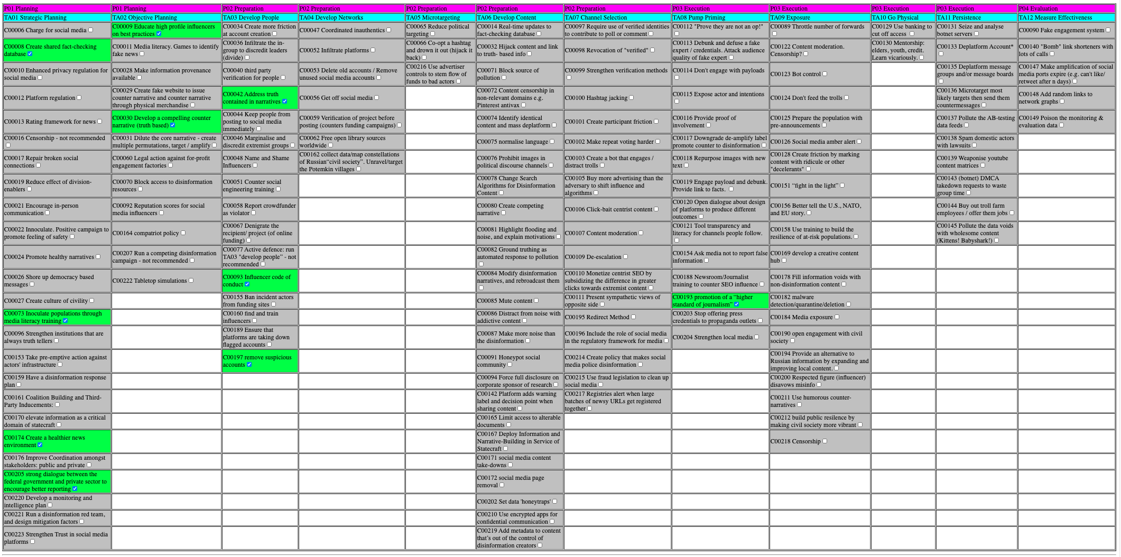
Example Responder Behaviours
C00009: Educate high profile influencers on best practices
C00008: Create shared fact-checking database
C00042: Address truth contained in narratives
C00030: Develop a compelling counter narrative (truth based)
C00093: Influencer code of conduct
C00193: promotion of a “higher standard of journalism”
C00073: Inoculate populations through media literacy training
C00197: remove suspicious accounts
C00174: Create a healthier news environment
C00205: strong dialogue between the federal government and private sector to encourage better reporting

Slide 27
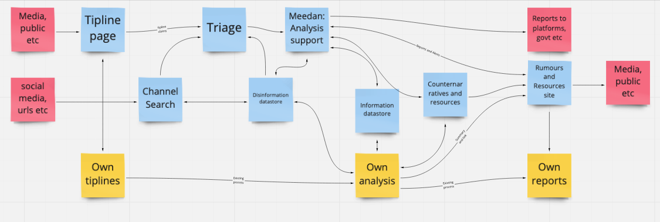
Practical: Resource Allocation
Tagging needs and groups with AMITT labels
Building collaboration mechanisms to reduce lost tips and repeated collection
Designing for future potential surges
Automating repetitive jobs to reduce load on humans
Notes:
Extra important that cross-group interfaces are efficient

Slide 28
Session 3.2: Response
Disinformation/Malign Influence Training
SJ Terp & P Breuer, Threet Consulting | 2021

Slide 29
Response
Responders
Responder types
Building response communities
types of misinformation and disinformation response groups that exist
types of responses that they can and do implement.
how to share information between responding groups.
Responses
Message-based responses: countermessaging, prebunking, debunking
Action-based responses
First, do no harm

Slide 30
Responders

Slide 31
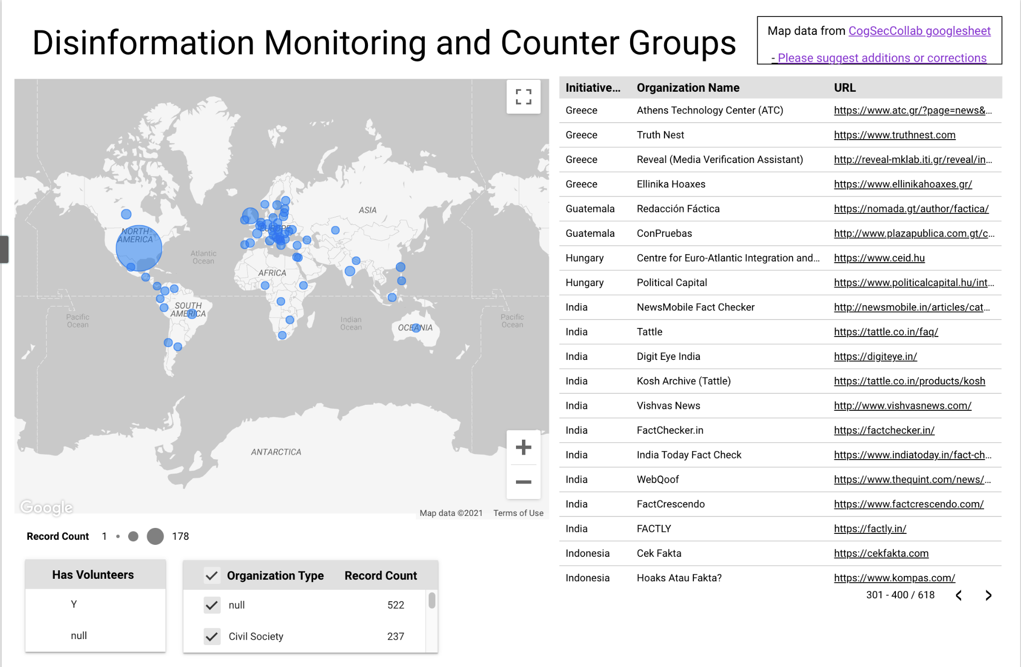
Responder Types
Government/ LE
Platform
Corporation
Media
Educator
Nonprofit
General Public
Community group
Influencer
Notes:
S: Mostly, when people think about cognitive security, they look at platforms, public and government as responders. But as we catalogued counters, we found many types of people, resources and groups who could help, with varying skills, availability, limitations, and resources.

Slide 32
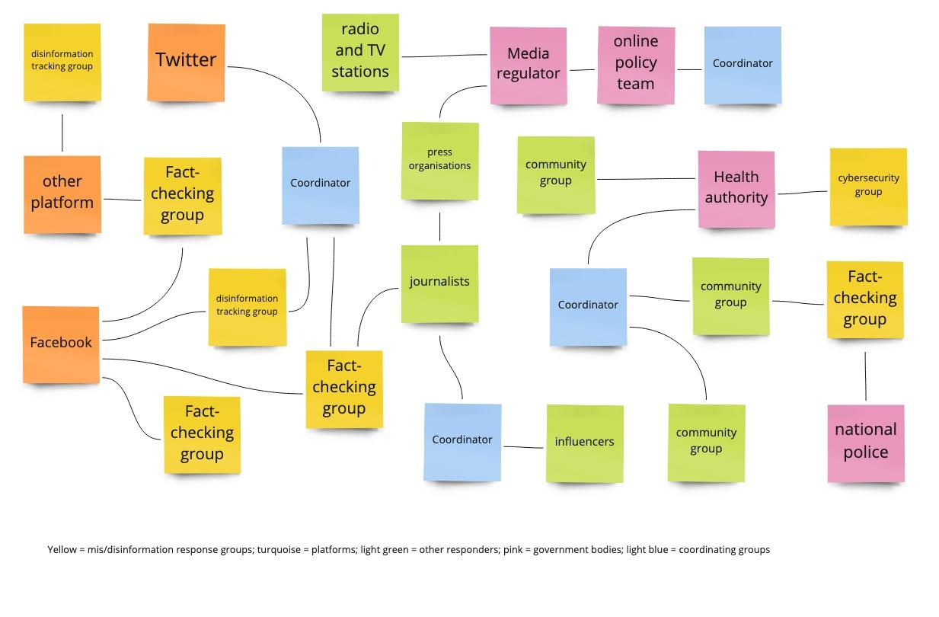
Typical configuration

Slide 33
Response behaviours

Slide 34
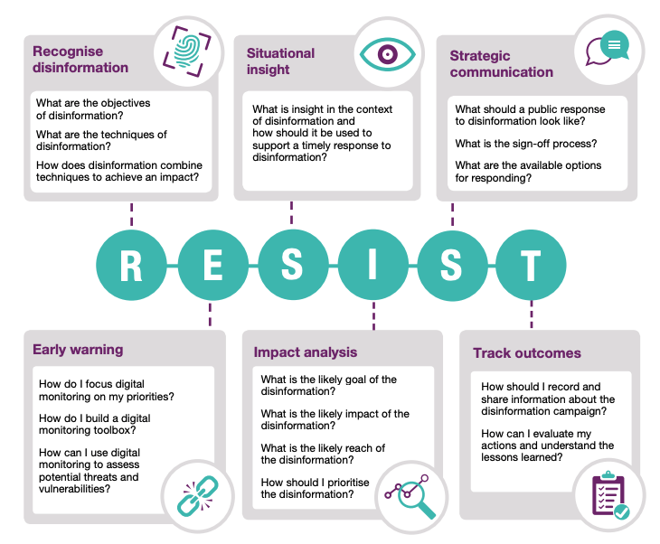
RESIST Framework

Slide 35
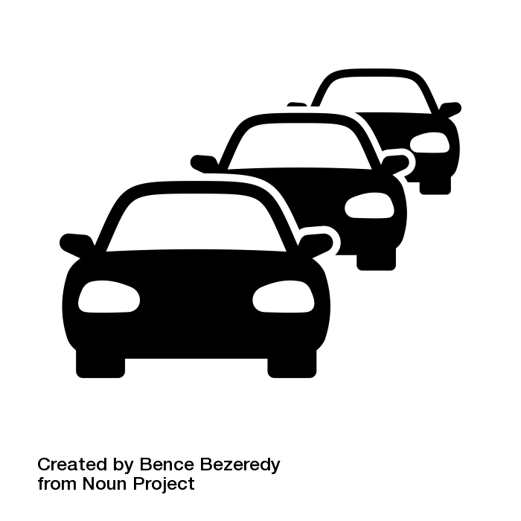





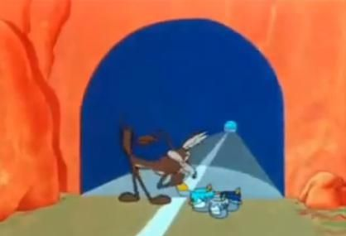
Intelligence community: Countermeasure categories
DESTROY
DETER
DENY
DETECT
DECEIVE
DISRUPT
DEGRADE
Notes:
Those JP 3-13 descriptions:
Destroy: damage a system or entity so badly that it cannot perform any function or be restored to a usable condition without being entirely rebuilt.
Deter: discourage. We added Deter to the list as a potentially useful category too.
Deny: prevent the adversary from accessing and using critical information, systems, and services.
Deceive: cause a person to believe what is not true. military deception seeks to mislead adversary decision makers by manipulating their perception of reality.
Disrupt: break or interrupt the flow of information.
Degrade: reduce the effectiveness or efficiency of adversary command and control or communications systems, and information collection efforts or means.
(Detect: discover or discern the existence, presence, or fact of an intrusion into information systems. We included Detect because that’s what everyone was doing - looking, not reacting, and we wanted them to get that out of their systems.)
See JP 3-0:

Slide 36
AMITT Blue: Countermeasures Framework
Planning
Preparation
Execution
Evaluation
Strategic Planning
Objective Planning
Develop People
Develop Networks
Microtargeting
Develop Content
Channel Selection
Pump Priming
Exposure
Go Physical
Persistence
Measure Effectiveness
Have a disinformation response plan
Media literacy through games
Find and train influencers
Remove old and unused accounts
Fill information voids
Hijack content and link to information
Rate-limit engagement
Microtarget likely targets with counter messages
Prebunking
DMCA takedown requests
Poison monitoring and evaluation data
Improve stakeholder coordination
Tabletop simulations
Counter-social engineering training
Unravel Potemkin villages
Stem flow of advertising money
Honeypot social community
Redirect searches away from disinfo
Train journalists to counter influence moves
Humorous counter narratives
Spam domestic actors with lawsuits
Bomb link shorteners with calls
Make civil society more vibrant
Make information provenance available
Ban incident actors from funding sites
Verify project before posting fund requests
Buy more advertising than disinformation creators
Corporate research funding full disclosure
Honeypot: fake engagement system
Tool transparency and literacy in followed channels
Mark content with ridicule / decelerants
Seize and analyse botnet servers
Add random links to network graphs
Red team disinformation, design mitigations
Block access to disinformation resources
Address truth in narratives
Encourage people to leave social media
Reduce political targeting
Real-time updates to factcheck database
Bot to engage and distract trolls
Ask media not to report false info
Expire social media likes/ retweets
Enhanced privacy regulation for social media
Educate influencers
Marginalise and discredit extremist groups
Deplatform message groups and boards
Co-opt disinformation hashtags
Remove non-relevant content from special interest groups
Strengthen verification methods
Repurpose images with counter messages
Influencer disavows misinfo
Platform regulation
Buy out troll farm employees / offer jobs
Ensure platforms are taking down accounts
Stop offering press credentials to disinformation outlets
Mentorship: elders, youth, credit
Content moderation
Verified ids to comment or contribute to poll
Engage payload and debunk
Cut off banking access
Shared fact checking database
Legal action against for-profit engagement farms
Name and shame disinformation influencers
Free open library sources
Prohibit images in political Chanels
Revoke whitelist / verified status
Debunk/ defuse fake expert credentials
Dampen emotional reaction
Repair broken social connections
Develop compelling counter narratives
Denigrate funding recipient / project
Social media source removal
Add metadata to original content
Don’t engage with payloads
Remove / rate limit botnets
Pre-emptive action against disinformation team infrastructure
Run competing campaigns
Infiltrate in-groups
Infiltrate disinformation platforms
Add warning labels on sharing
Hashtag jacking
Social media amber alert
Etc
Etc
Etc
Etc
Etc
Etc
Etc
Notes:
This is the AMITT Blue framework: it contains 160 countermoves to the campaign and incident techniques that we analysed with AMITT Red. We used information operations frameworks to create this, specifically the classifications Deny, Disrupt:, Degrade, Deceive:, Destroy, and Deter - for each tactic stage and Red technique.
We’ve partnered with counter-disinformation groups like RealityTeam.org who use targeted counter messaging and metrics to push away disinformation narratives. And we’re currently cleaning this matrix up.

Slide 37
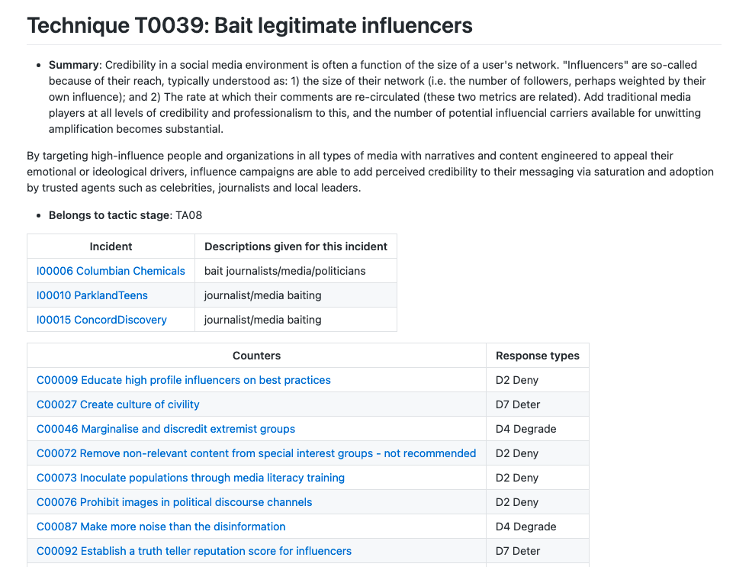
Red/Blue teaming: using blue to red links

Slide 38
Communication-based responses

Slide 39
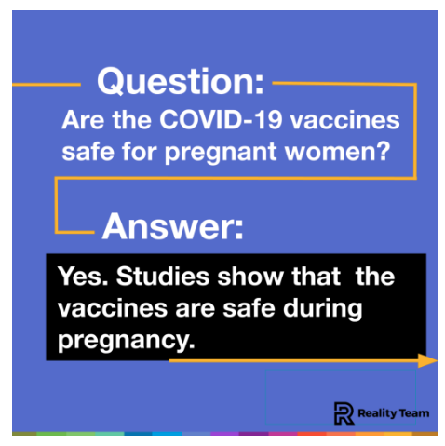
Countermessaging
Notes:
Counters illusory truth bias

Slide 40
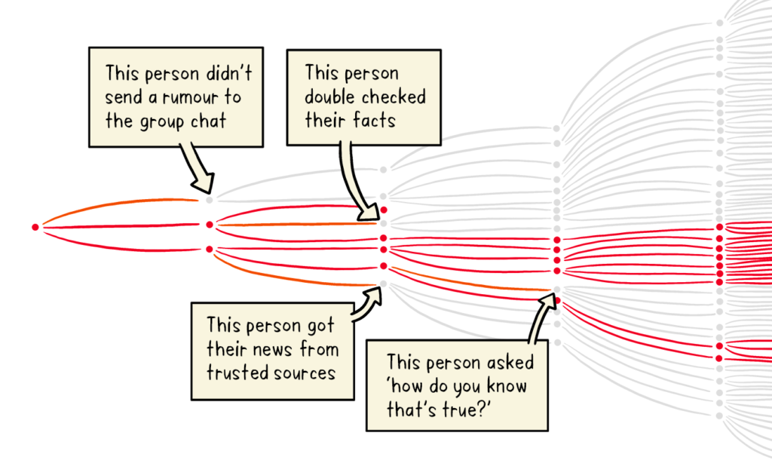
Pre-bunking and truth sandwiches
Notes:
Prebunking: owning the narrative space before an anticipated narrative becomes widespread. One of the simplest ways to do this is train people on what influence looks like, using training or games.
Truth sandwich: truth, lie, truth
https://firstdraftnews.org/articles/a-guide-to-prebunking-a-promising-way-to-inoculate-against-misinformation/
https://medium.com/wehearthealthliteracy/the-truth-sandwich-a-better-way-to-mythbust-8021d2cf8730
Image: WHO
Includes playing “Go Viral!”
Counters familiarity backfire

Slide 41
Engage: Dennett’s 4 points
1. Attempt to re-express your target’s position so clearly, vividly and fairly that your target says: “Thanks, I wish I’d thought of putting it that way.”
2. List any points of agreement (especially if they are not matters of general or widespread agreement).
3. Mention anything you have learned from your target.
4. Only then are you permitted to say so much as a word of rebuttal or criticism.
Notes:
https://techindc.com/confirmation-bias/3063/
Counters confirmation bias

Slide 42
Environment-based responses

Slide 43
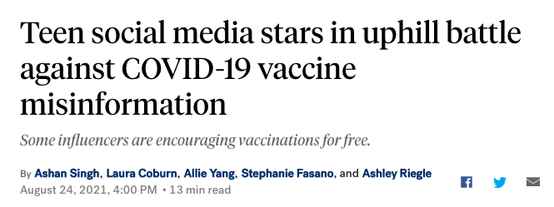
Improve the information/influence environment
Notes:
Report, remove, re-route disinformation isn’t enough. Change the influence space, and build influence capacity in it. Indian aunties. Barbershops. Etc. Train influencers. Meet with response communities, so nobody’s learning about each other as an incident hits. Listen to communities about what they need and how.
Counters information overload
https://www.demdigest.org/a-better-way-to-counter-astroturfing-disinformation-technology-and-democracy-in-transition/

